Slide 1



Predicting Diabetes Patient
Hospital Readmissions
A Risk Scoring System for Hospital Planning Teams
Data Analytics Capstone Project | General Assembly DABPT03
Ram Jeevan | February 28 2026
Notes:
‹#›

Slide 2
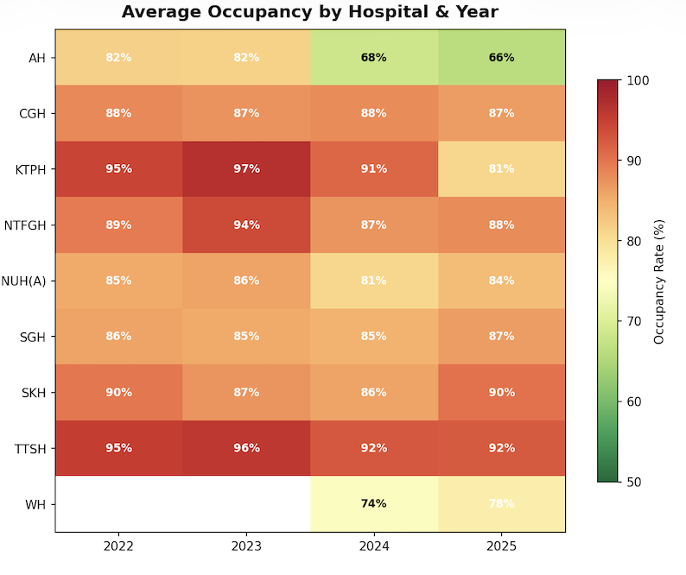
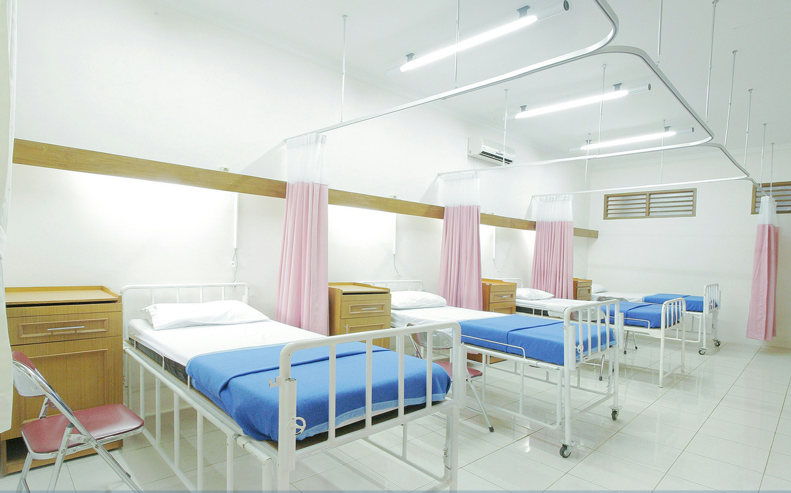

Singapore’s Hospital Bed Occupancy
Rising elderly population leads to a forecasted increase in a demand for hospital beds.
Beyond the system: hospital admissions are exhausting, expensive and disruptive for patients
SOURCE: MOH Singapore; Department of Statistics Singapore
2
Notes:
‹#›

Slide 3

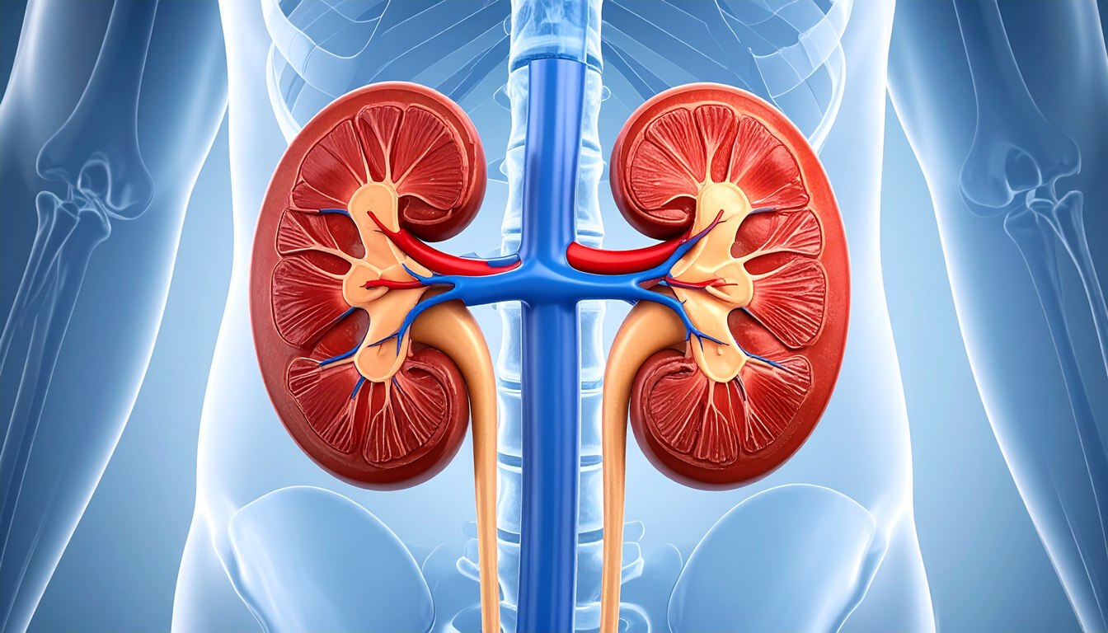

Diabetic Admissions
Diabetes affects 11–14% of Singapore's adult population - one of the highest rates in developed Asia
Diabetes accounts for around 1 in 5 of all admissions in Singapore. Some of the main Diabetic complications that result in admissions are:
Foot Amputations
Kidney Failure
Cardiovascular Disease and Stroke
SOURCE: Ministry of Health & Health Promotion Board. (2025, October 17). National Population Health Survey (NPHS) 2024 report
3
Notes:
‹#›

Slide 4
Solution: Predictive Risk Scoring
Prepare Data
Machine Learning Model
Risk Score
Gather and prepare data on patient age, medications,
prior visits, diagnoses,
length of stay upon discharge
→
→
An Algorithm understands patterns from the data.
The model assigns individual patients with a 0-100%
probability score upon discharge.
Example: A patient with 75% score is much more likely to return than one with 25%.
Patients with over 50% probability are categorised 1 (chance to readmit) while those below 50% are grouped as 0 (will not readmit).
4
Notes:
‹#›

Slide 5
Dataset: UCI’s Diabetic Readmissions across 130 US Hospitals from 1999 to 2008 [101,766 encounters]
Category | Examples | Rows
Demographics | Age, gender, race, payer code | 4
Encounter Info | Admission type, discharge destination, time in hospital, number of procedures done, medical specialty of doctor (numerical and categorical) | 14
Diagnoses | Primary, secondary, tertiary diagnosis types (can include non-diabetic diagnosis) | 3
Medications | Diabetic medications that featured most prominently EG metformin, insulin, glipizide | 7
SOURCE: Diabetes 130-US Hospitals for Years 1999-2008; UCI Machine Learning Repository
5
Notes:
(1) It is an inpatient encounter (a hospital admission).
(2) It is a diabetic encounter, that is, one during which any kind of diabetes was entered into the system as a diagnosis.
(3) The length of stay was at least 1 day and at most 14 days.
(4) Laboratory tests were performed during the encounter.
(5) Medications were administered during the encounter.
‹#›

Slide 6
Two Models for Two Functions
Model 1: Any Readmission
Model 2: 30-Day Readmission
"What is their chance of readmission?"
"Their chance of readmission within 30 days."
• Aim to identify ~7 out of 10 patients who will be readmitted
• Useful for research and discharge planning.
• More accurate model because it is a broader target.
• Most urgent cases, likely highest resource use.
• Useful for forecasting hospital resource needs.
• Because it is a smaller percentage of the dataset, a predictive model will require special treatment and be less accurate.
46%
11%
of patients in the dataset
are readmitted
of patients in the dataset
are readmitted within 30 days
SOURCE: Diabetes 130-US Hospitals for Years 1999-2008; UCI Machine Learning Repository
6
Notes:
‹#›

Slide 7
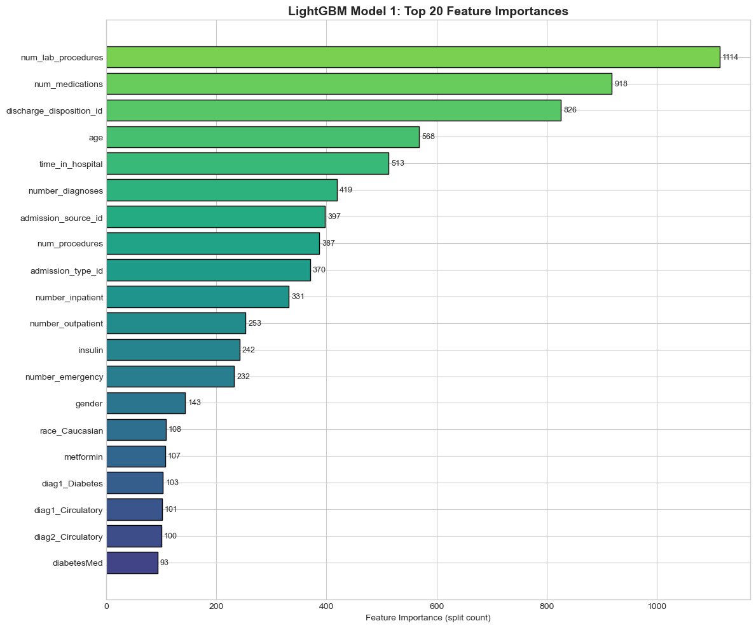
Key Contributing Factors (Any)
SOURCE: LightGBM feature importance analysis
The strongest predictor of future admissions is number of lab procedures. This indicates that the patient is in a highly critical state
Other strong predictors: number of medications, discharge destination
Removing prior visit history drops model accuracy significantly from 70% to 57%.
7
Notes:
The strongest predictor of future admissions is past admissions.
Other strong predictors: number of medications, discharge destination
Removing prior visit history drops model accuracy from 70% to 57%
‹#›

Slide 8
Model Accuracy & What It Means
Any Readmission Model
30-Day Model (Tuned)
69%
Correctly ranks about 70% of patients.
67%
Catches 67% of urgent cases
AUC
AUC
Predicted 56% of all readmission correctly.
Has a 49.7% chance of predicting readmission correctly (with threshold at 0.3).
What does this mean for implementation?
• Treat scores as recommendations, not rigid rules
• Clinical judgement still matters most. The model supports decisions, doesn't replace them
• Even modest improvements in targeting can free up beds and improve outcomes
SOURCE: Diabetes 130-US Hospitals for Years 1999-2008; UCI Machine Learning Repository
9
Notes:
For clinical applications, generally this is a decent guideline and companion, not a substitute for clinical judgement. Healthcare is generally complex and determinant on socio economic factors, lifestyle, genetics, body types etc, so it would not be realistic to aim for something like an 80%.
‹#›

Slide 9
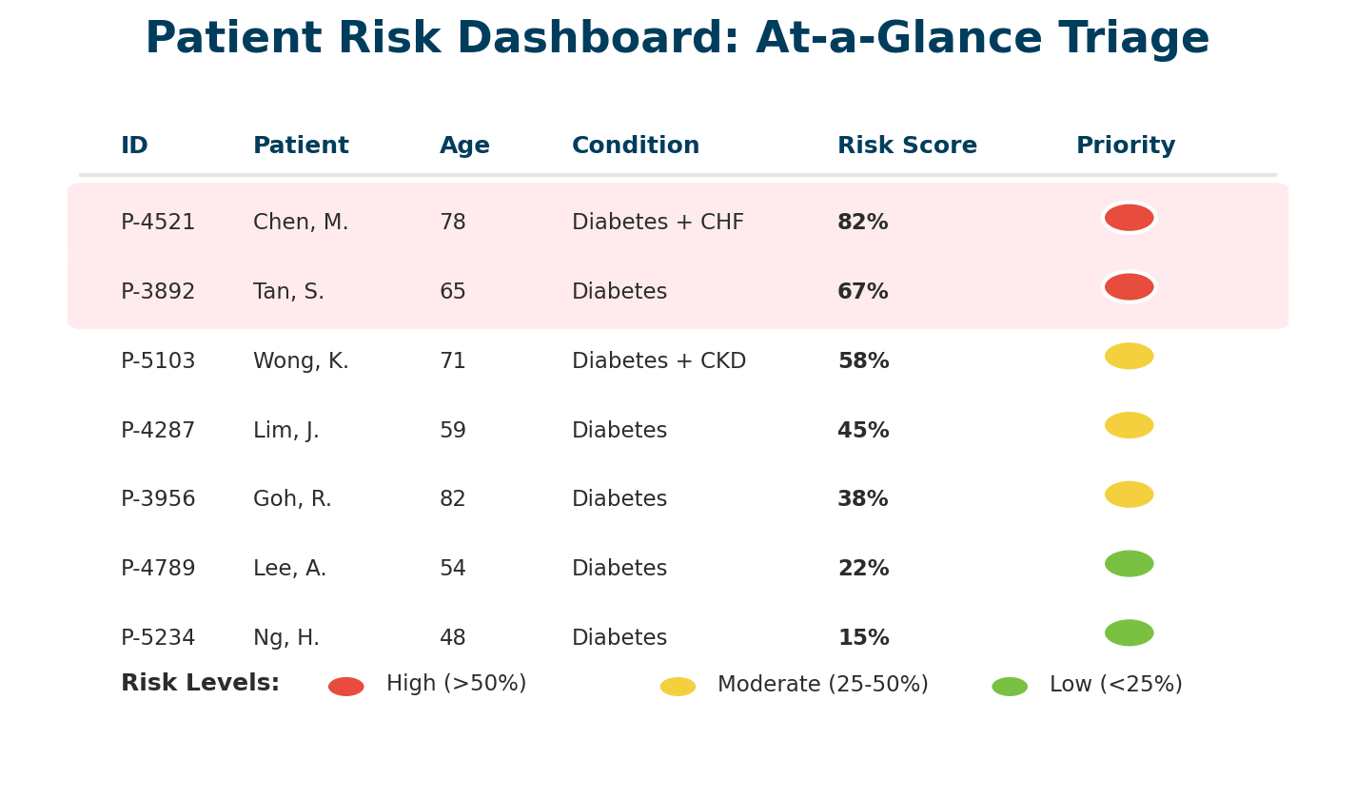
Implementation - Clinical Teams
10
Notes:
This is a possible depiction of how the model could be implemented in practice - it could pop up as an additional field under the patient’s data, which would allow planning teams to have an instant view of the risk scores before going granular into the details of each patient. This gives a big picture view of how many high-risk patients there are. Additionally, they can be colour coded based on their risk range, which can group them into different support tiers and groups.
‹#›

Slide 10
Implementation - Resource Planning
This Week's Discharges: 500 patients
High: 80
Medium: 120
Low: 300
Bed Planning
Staff Allocation
Impact Tracking
Expect ~40+ high-risk patients to return within 30 days. Reserve capacity accordingly.
Need capacity for 200 follow-up calls (80 urgent + 120 standard) this week.
Track if interventions reduce actual return rates over time.
Proactive and Efficient Forecasting
11
Notes:
In the bigger picture, a weekly discharge review can be churned out. This allows hospital teams to have a broad overview/ estimation of how many beds would be needed, allowing for better preparedness.
‹#›

Slide 11
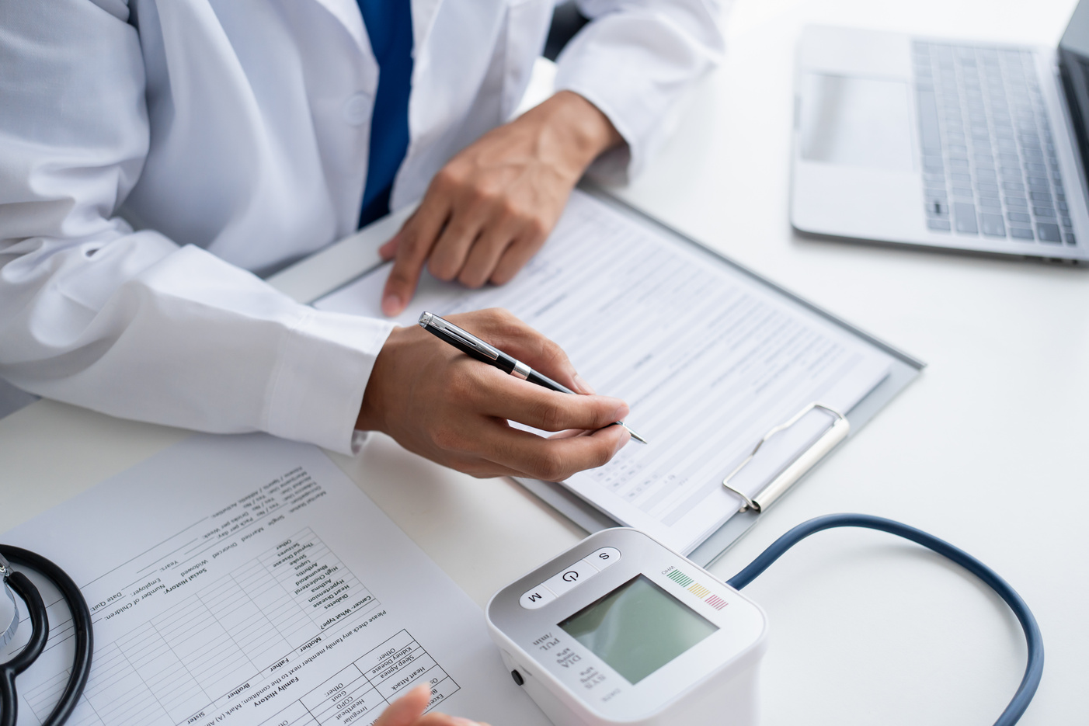
Clinical Exploration
🔬
‘False Positive’ Analysis
Clinical teams can study the False Positive Data — patients who were flagged for readmission but did not actually readmit.
By examining what these patients have in common, clinicians can identify protective factors and understand what makes recovery successful.
13
Notes:
Using the False Positive Data to study why a person predicted readmitted was not readmitted
‹#›

Slide 12

Getting more accurate predictions
Beyond getting Singapore data, additional data collection could strengthen the model
⚖️
🏠
Weight
Singapore Specifc
Socio-Economic Status
Patient weight is a critical clinical indicator linked to chronic conditions, malnutrition risk, and post-discharge complications.
Local data is essential to train the model before implementation.
Socioeconomic factors — income, insurance, housing, family support system — are strong predictors of whether patients can manage recovery at home.
12
Notes:
‹#›

Slide 13
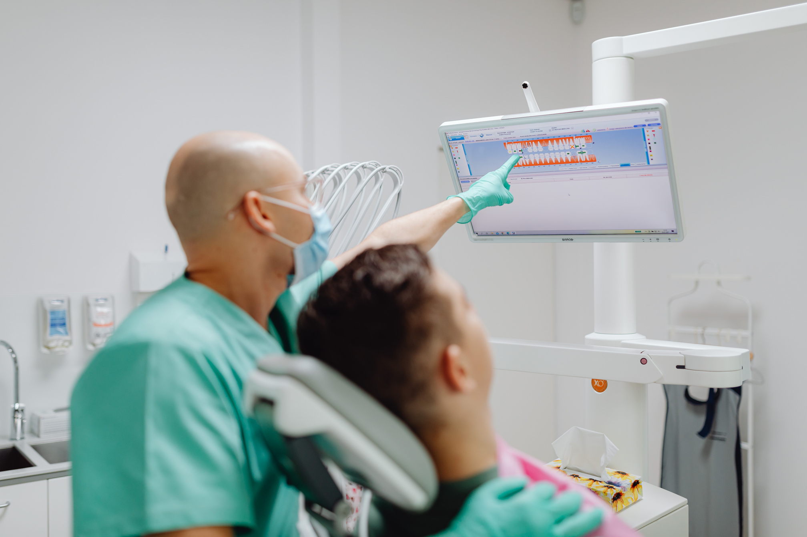
Looking Ahead: Prevention Over Reaction
The Future
Predicting first-time admissions: Gather data to predict the probability of first-time admissions
Models predicting even 10-15% of future admissions could be transformative for preventive healthcare.
SOURCE: HeatlhHub Singapore
14
Notes:
‹#›

